Slide 1
UML Diagrams

Slide 2
What is UML ?
UML stands for “Unified Modeling Language”
It is a industry-standard graphical language since it provides a common, standardized way to visualize, specify, construct, and document software systems, improving communication and collaboration between diverse stakeholders.
The UML uses mostly graphical notations to express the OO analysis and design (a software engineering approach that models systems as interacting objects to improve design quality and maintainability) of software projects.
Simplifies the complex process of software design.

Slide 3
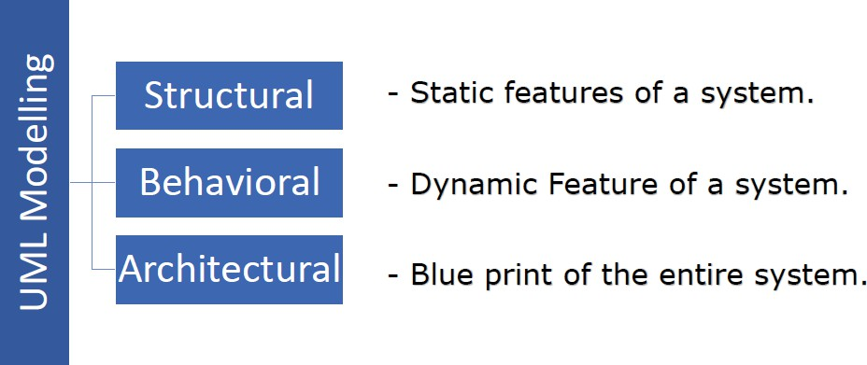

Slide 4
Behavior diagrams : Behavior diagrams emphasize what must happen in the system being modeled. Since behavior diagrams illustrate the behavior of a system, they are used extensively to describe the functionality of software systems.
Structure diagrams :Structure diagrams emphasize the things that must be present in the system being modeled. Since structure diagrams represent the structure, they are used extensively in documenting the software architecture of software systems

Slide 5
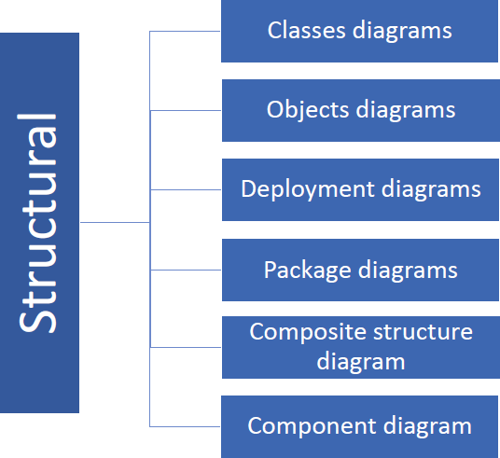

Slide 6
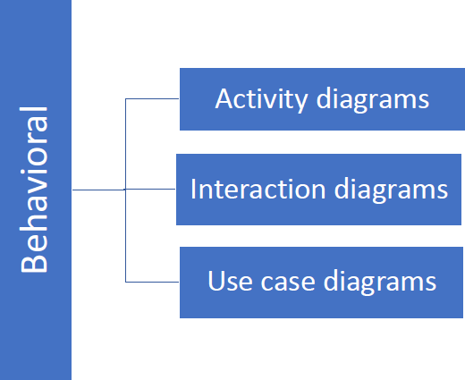

Slide 7
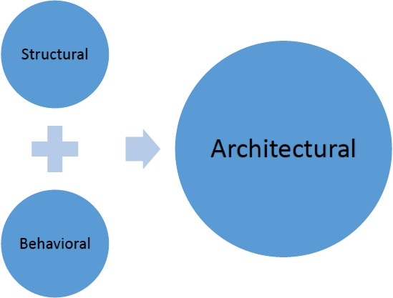

Slide 8
Types of UML Diagram
Use Case Diagram
Class Diagram
Sequence Diagram
Collaboration Diagram
State Diagram
Activity Diagram
Component Diagram
Deployment Diagram

Slide 9
USE CASE DIAGRAM
Use case diagrams consist of actors, use cases and their relationships. The diagram is used to model the system of an application.
Actors in a diagram represent a role played by a user, system, or organization that interacts with the system being modeled.
Use cases are descriptions of how users or other systems interact with a product or system to achieve a specific goal, serving as a way to define requirements and plan development.
A single use case diagram captures a particular functionality of a system.
The purposes of use case diagrams can be as follows:
Use to gather requirements of a system.
Use to get an outside view of a system.
Show the interaction among the requirements and actors.
Notes:
Actors in a diagram represent a role played by a user, system, or organization that interacts with the system being modeled.
Use cases are descriptions of how users or other systems interact with a product or system to achieve a specific goal, serving as a way to define requirements and plan development.
A use case diagram is a visual representation of a system's users and their interactions with the system's functionality. It shows what a system does from the user's perspective, not how it does it. The key components are actors (users or external systems), use cases (functions or goals), and the relationships between them.

Slide 10
When we are planning to draw an use case diagram we should have the following items identified.
Functionalities to be represented as an usecase
Actors
Relationships among the use cases and actors.
The following are the places where use case diagrams are used:
Requirement analysis and high level design.
Model the context of a system.

Slide 11
Follow the following guidelines to draw an efficient use case diagram.
The name of a use case is very important. So the name should be chosen in such a way so that it can identify the functionalities performed.
Give a suitable name for actors.
Show relationships and dependencies clearly in the diagram.
Do not try to include all types of relationships because the main purpose of the diagram is to identify requirements.

Slide 12

Use Case Diagram
Describes the functionality provided by a system in terms of actors, their goals represented as use cases, and any dependencies among those use cases.
Used for describing a set of user scenarios
Mainly used for capturing user requirements
Work like a contract between end user and software developers

Slide 13
Relationship in use case diagram
Association: communication between an actor and a use case;
Represented by a solid line.
Generalization: relationship between one general use case and a special use case. Represented by a line with a triangular
arrow head toward the parent use case.
Include: a dotted line labeled <<include>> beginning at base use case and ending with an arrows pointing to the include use case.
Extend: a dotted line labeled <<extend>> with an arrow toward the base case. The extending use case may add behavior to the base use case.
Association:
Generalization:
<<include>>
<<extend>>

Slide 14
Relationship in use case diagram cont.
1. Association:
An association represents a basic communication link between an actor and a use case.
It indicates that an actor initiates or interacts with a use case to achieve a specific goal.
Notation: A solid line connecting an actor to a use case.
2. Generalization:
Generalization represents an "is-a" relationship, indicating that one element (actor or use case) is a specialized version of another, more general element.
For Actors: A child actor inherits the capabilities and interactions of its parent actor. For example, a "Bank Teller" actor might generalize a "Bank Employee" actor.

Slide 15
Relationship in use case diagram cont.
For Use Cases: A child use case inherits the functionality of its parent use case and may add specific variations or extensions. For example, "Process International Transfer" might generalize "Process Transfer."
Notation: A solid line with an unfilled triangular arrowhead pointing from the specialized element (child) to the general element (parent).
3. Include (<<include>>):
The include relationship represents a mandatory dependency where one use case (the base use case) incorporates the behavior of another use case (the included use case).
The included use case is a necessary part of the base use case's functionality and cannot exist independently in that context. It is often used to factor out common, reusable behavior.
Notation: A dashed arrow with an open arrowhead pointing from the base use case to the included use case, labeled with the stereotype <<include>>.

Slide 16
Relationship in use case diagram cont.
4. Extend (<<extend>>)
The extend relationship represents an optional extension of a base use case's behavior under specific conditions.
The extending use case provides additional functionality that may or may not be executed, depending on certain extension points or conditions within the base use case. The base use case can be complete and meaningful without the extension.
Notation: A dashed arrow with an open arrowhead pointing from the extending use case to the base use case, labeled with the stereotype <<extend>>. Extension points in the base use case can be specified.

Slide 17
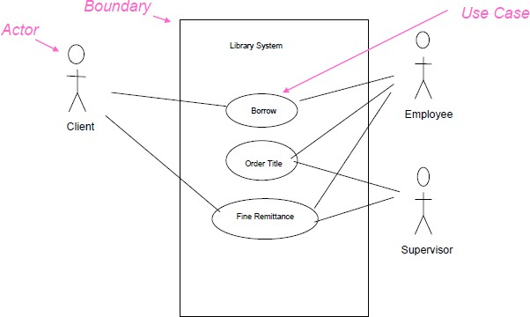
An Example of Use Case Diagram

Slide 18
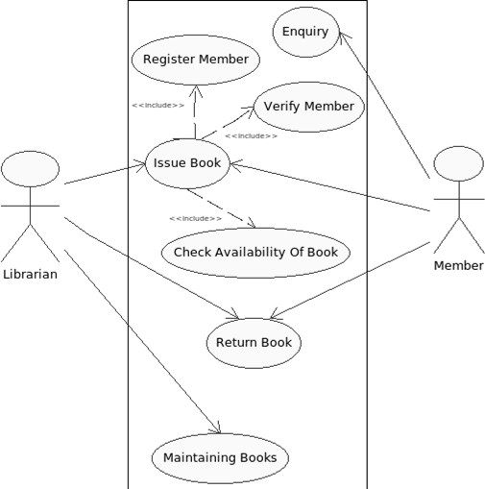

Slide 19
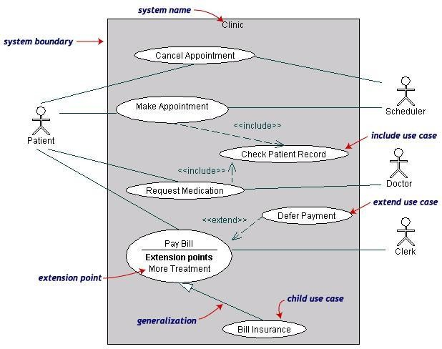
Example:

Slide 20
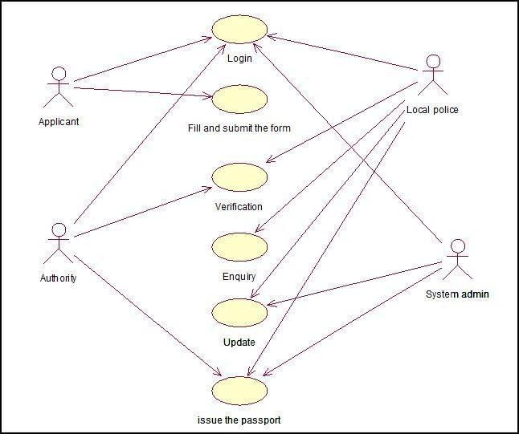
Use case Diagram for Passport Automation System

Slide 21
CLASS DIAGRAM
The class diagram is a static diagram. It represents the static view of an application.
A Class diagram models the static structure of a system.
It shows relationships between classes, attributes, and operations.
A class has three parts; name at the top, attributes in the middle and operations/methods at the bottom.
The functionality provided by the termed “methods” of the class.
Attribute uniquely identify the class.
class are

Slide 22
Purpose of the class diagram:
Analysis and design of the static view of an application.
Describe responsibilities of a system.
Base for component and deployment diagrams.

Slide 23
Class Representation
Each class is represented by a
rectangle
subdivided into three compartments
Name
Attributes
Operations
Modifiers are used to indicate
visibility of
attributes and operations.
‘+’ is used to denote Public visibility (everyone)
‘#’ is used to denote Protected visibility (friends and derived)
‘-’ is used to denote Private visibility (no one)
By default, attributes are hidden and operations are visible.

Slide 24
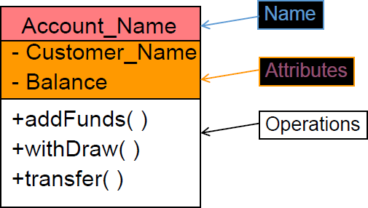
An example of Class

Slide 25
End

